Slide 1
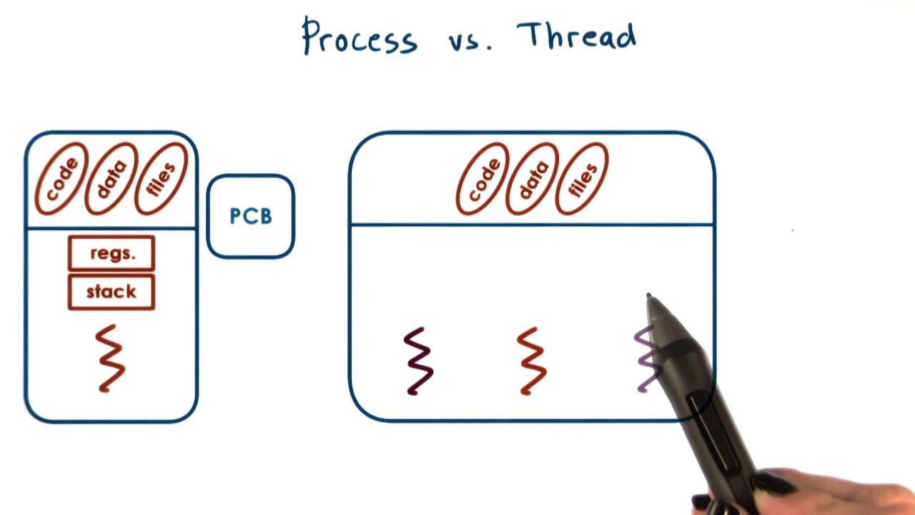

CS-3103 : Operating Systems : Sec-A (NB) : Threads & Concurrency

Slide 2
Processes and Threads
Traditional processes have two characteristics:
Resource Ownership
Scheduling/Execution
  Process includes a virtual address space to hold the process image
    the OS provides protection to prevent unwanted interference between processes with respect to resources
Follows an execution path that may be interleaved with other processes
  a process has an execution state (Running, Ready, etc.) and a dispatching priority and is scheduled and dispatched by the OS
  Traditional processes are sequential; i.e. only one execution path

Slide 3
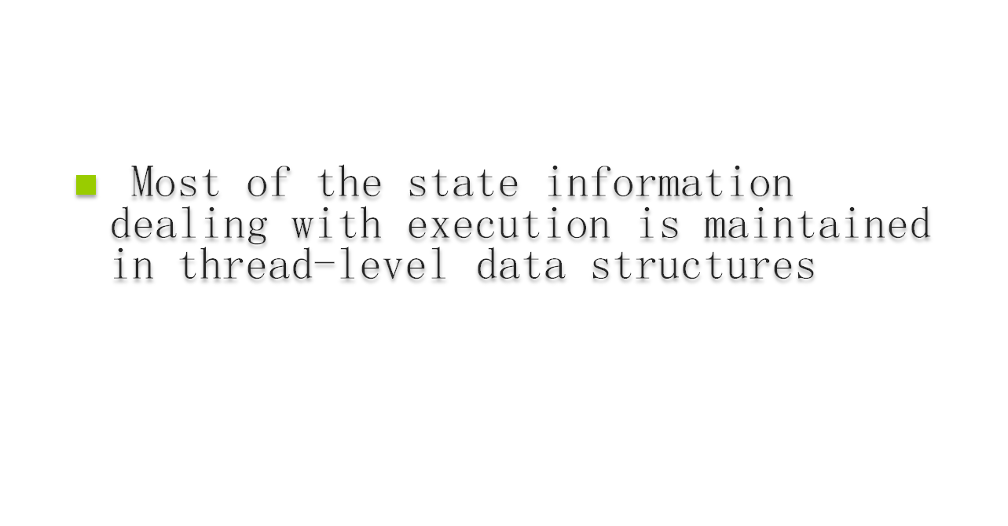
In an OS that supports threads, scheduling and dispatching is done on a thread basis
  suspending a process involves suspending all threads of the process
  termination of a process terminates all threads within the process

Slide 4
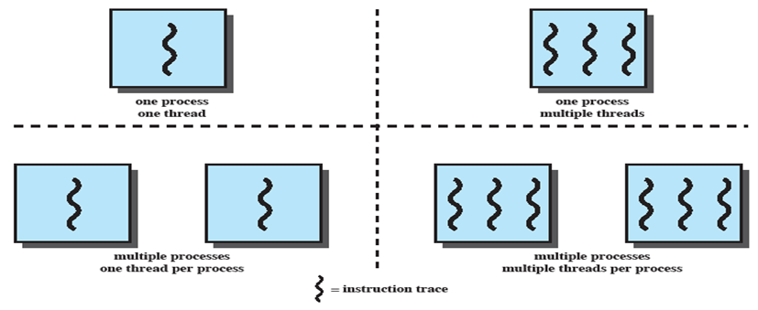
Process and Threads

Slide 5
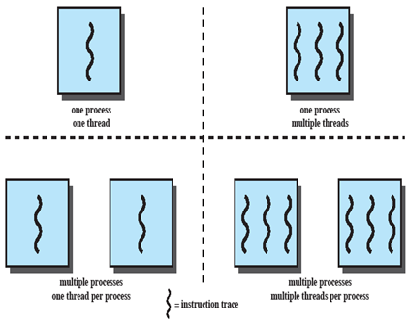
Multithreaded Approaches
The right half of the Fig. depicts multithreaded approaches
A Java run-time environment is a system of one process with multiple threads; Windows, some UNIXes, support multiple multithreaded processes.

Slide 6
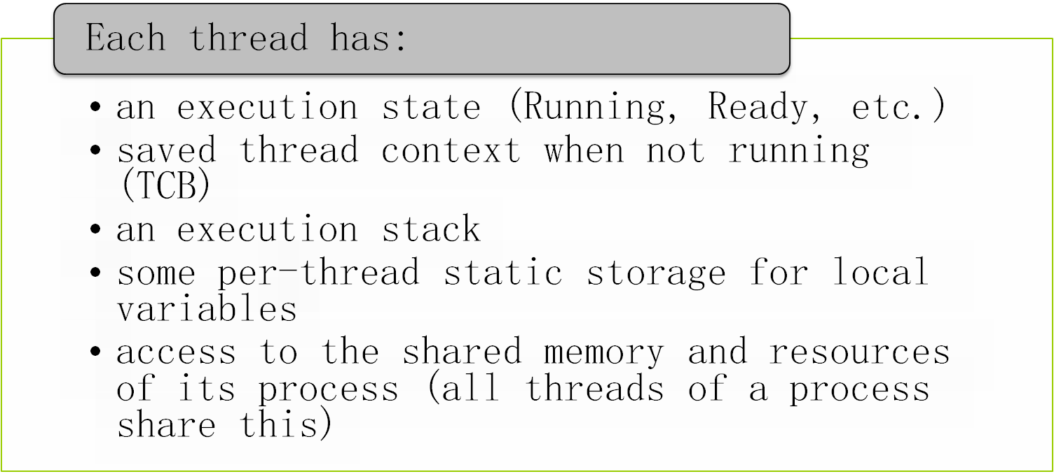

One or More Threads in a Process

Slide 7
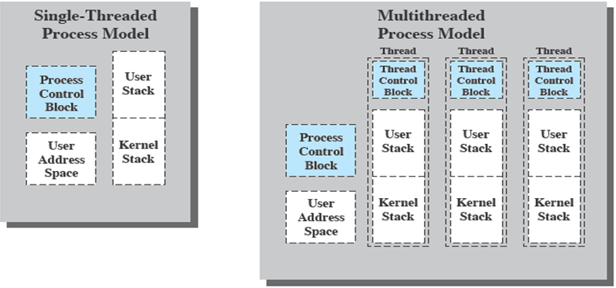
Threads vs. Processes

Slide 8
Thus, all of the threads of a process share the state and resources of that process. They reside in the same address space and have access to the same data. When one thread alters an item of data in memory, other threads see the results if and when they access that item. If one thread opens a file with read privileges, other threads in the same process can also read from that file.
The key benefits of threads derive from the performance implications:
1. It takes far less time to create a new thread in an existing process than to
create a brand-new process. Studies done by the Mach developers show that
thread creation is ten times faster than process creation in UNIX [TEVA87].
2. It takes less time to terminate a thread than a process.
3. It takes less time to switch between two threads within the same process than to switch between processes.
4. Threads enhance efficiency in communication between different executing programs. In most operating systems, communication between independent processes requires the intervention of the kernel to provide protection and the mechanisms needed for communication. However, because threads within the same process share memory and files, they can communicate with each other without invoking the kernel.
Thus, if there is an application or function that should be implemented as a set of related units of execution, it is far more efficient to do so as a collection of threads rather than a collection of separate processes.

Slide 9
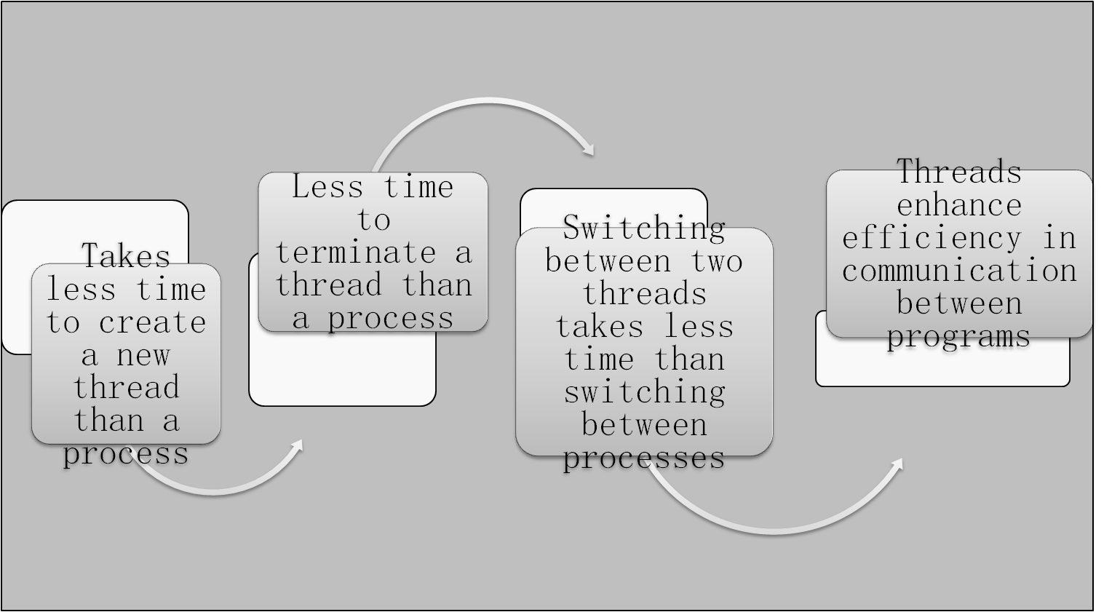
Benefits of Threads

Slide 10
In an OS that supports threads, scheduling and dispatching is done on a thread basis;
hence, most of the state information dealing with execution is maintained in thread-level data structures. There are, however, several actions that affect all of the threads in a process and that the OS must manage at the process level.
For example, suspension involves swapping the address space of one process out of main memory to make room for the address space of another process.
Because all threads in a process share the same address space, all threads are suspended at the same time. Similarly, termination of a process terminates all threads within that process.

Slide 11
Thread operations associated with a change in thread state are:
      Spawn (create)
      Block
      Unblock
      Finish
The key states for a thread are:
      Running
      Ready
      Blocked

Slide 12
THREAD STATES
As with processes, the key states for a thread are Running, Ready, and Blocked. Generally, it does not make sense to associate suspend states with threads because such states are process-level concepts. In particular, if a process is swapped out, all of its threads are necessarily swapped out because they all share the address space of the process. There are four basic thread operations associated with a change in thread state [ANDE04]:
• Spawn: Typically, when a new process is spawned, a thread for that process is also spawned. Subsequently, a thread within a process may spawn another thread within the same process, providing an instruction pointer and arguments for the new thread. The new thread is provided with its own register context and stack space and placed on the ready queue.
• Block: When a thread needs to wait for an event, it will block (saving its user registers, program counter, and stack pointers). The processor may now turn to the execution of another ready thread in the same or a different process.
• Unblock: When the event for which a thread is blocked occurs, the thread is moved to the Ready queue.
• Finish: When a thread completes, its register context and stacks are deallocated.

Slide 13
Thread Synchronization
It is necessary to synchronize the activities of the various threads
      all threads of a process share the same address space and other resources
      any alteration of a resource by one thread affects the other threads in the same process
Notes:
THREAD SYNCHRONIZATION
All of the threads of a process share the same address space and other resources, such as open files. Any alteration of a resource by one thread affects the environment of the other threads in the same process. It is therefore necessary to synchronize the activities of the various threads so that they do not interfere with each other or corrupt data structures. For example, if two threads each try to add an element to a doubly linked list at the same time, one element may be lost or the list may end up malformed. The issues raised and the techniques used in the synchronization of threads are, in general, the same as for the synchronization of processes. These issues and techniques are the subject of Chapters 5 and 6 .

Slide 14


Slide 15
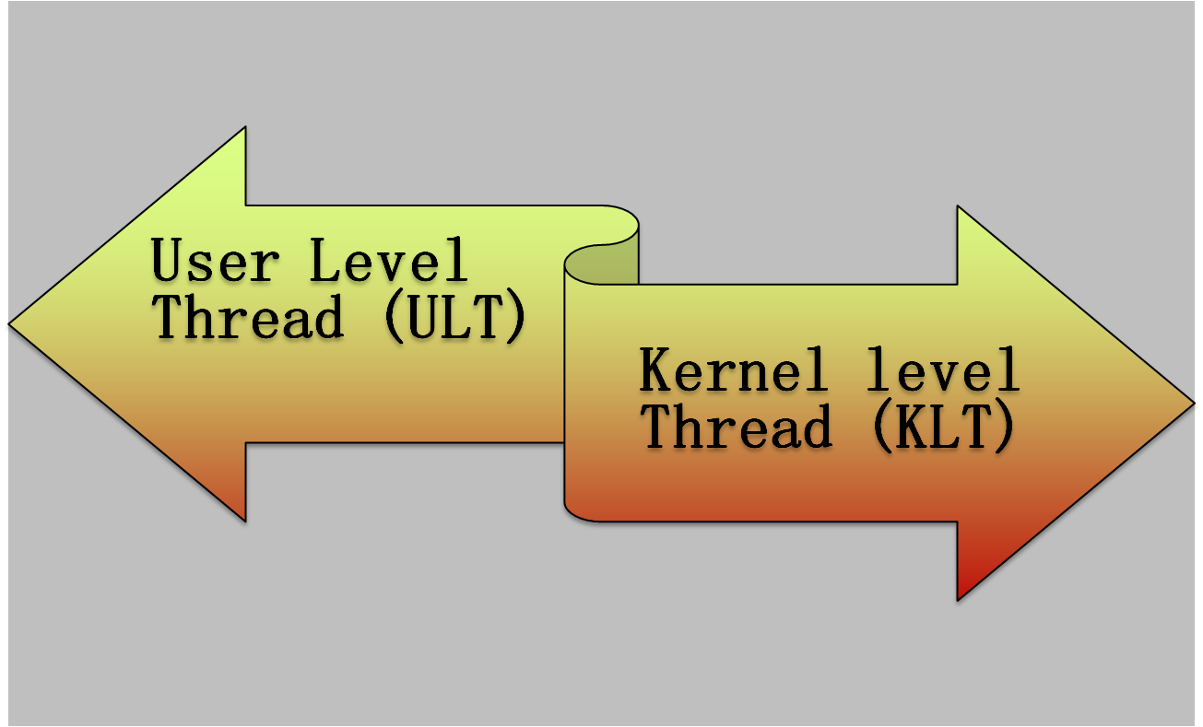
Types of Threads
Notes:
User-Level and Kernel-Level Threads
There are two broad categories of thread implementation: user-level threads (ULTs) and kernel-level threads (KLTs). The latter are also referred to in the literature as kernel-supported threads or lightweight processes.

Slide 16
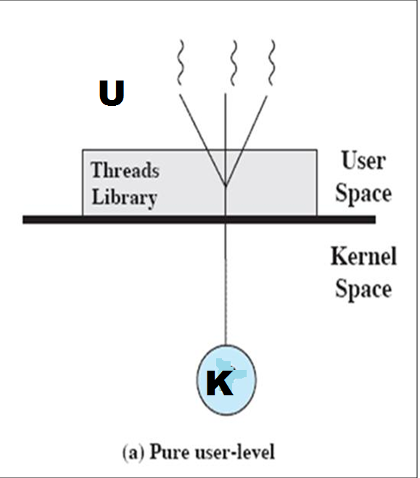
User-Level Threads (ULTs)
Thread management is done by the application
The kernel is not aware of the existence of threads
User creates thread(s) using pthread_create(….) function.
Notes:
USER-LEVEL THREADS
In a pure ULT facility, all of the work of thread management is done by the application and the kernel is not aware of the existence of threads. Figure 4.5a illustrates the pure ULT approach. Any application can be programmed to be multithreaded by using a threads library, which is a package of routines for ULT management. The threads library contains code for creating and destroying threads, for passing messages and data between threads, for scheduling thread execution, and for saving and restoring thread contexts.
By default, an application begins with a single thread and begins running in that thread. This application and its thread are allocated to a single process managed by the kernel. At any time that the application is running (the process is in the Running state), the application may spawn a new thread to run within the same process. Spawning is done by invoking the spawn utility in the threads library. Control is passed to that utility by a procedure call. The threads library creates a data structure for the new thread and then passes control to one of the threads within this process that is in the Ready state, using some scheduling algorithm. When control is passed to the library, the context of the current thread is saved, and when control is passed from the library to a thread, the context of that thread is restored. The context essentially consists of the contents of user registers, the program counter, and stack pointers.

Slide 17
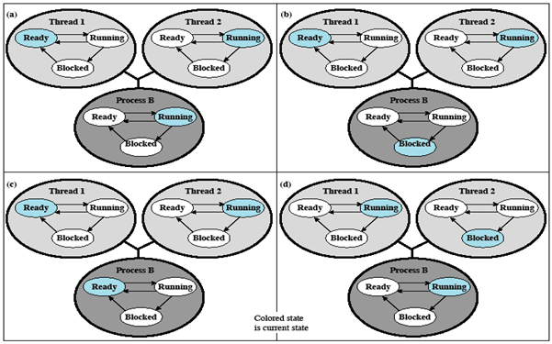
Relationships Between ULT States and Process States
Possible transitions from Xa: Xa→Xb; Xa→Xc; Xa→Xd
Figure X: Examples of the Relationships between User-Level Thread States and Process States
Notes:
All of the activity described in the preceding paragraph takes place in user space and within a single process. The kernel is unaware of this activity. The kernel continues to schedule the process as a unit and assigns a single execution state (Ready, Running, Blocked, etc.) to that process. The following examples should clarify the relationship between thread scheduling and process scheduling. Suppose that process B is executing in its thread 2; the states of the process and two ULTs that are part of the process are shown in Figure 4.6a . Each of the following is a possible occurrence:
1. The application executing in thread 2 makes a system call that blocks B. For
example, an I/O call is made. This causes control to transfer to the kernel. The kernel invokes the I/O action, places process B in the Blocked state, and switches to another process. Meanwhile, according to the data structure maintained by the threads library, thread 2 of process B is still in the Running state. It is important to note that thread 2 is not actually running in the sense of being executed on a processor; but it is perceived as being in the Running state by the threads library. The corresponding state diagrams are shown in Figure 4.6b .
2. A clock interrupt passes control to the kernel and the kernel determines
that the currently running process (B) has exhausted its time slice. The kernel places process B in the Ready state and switches to another process. Meanwhile, according to the data structure maintained by the threads library, thread 2 of process B is still in the Running state. The corresponding state diagrams are shown in Figure 4.6c .
3. Thread 2 has reached a point where it needs some action performed by thread
1 of process B. Thread 2 enters a Blocked state and thread 1 transitions from Ready to Running. The process itself remains in the Running state. The corresponding state diagrams are shown in Figure 4.6d .
In cases 1 and 2 ( Figures 4.6b and 4.6c ), when the kernel switches control back to process B, execution resumes in thread 2. Also note that a process can be interrupted, either by exhausting its time slice or by being preempted by a higher priority process, while it is executing code in the threads library. Thus, a process may be in the midst of a thread switch from one thread to another when interrupted. When that process is resumed, execution continues within the threads library, which completes the thread switch and transfers control to another thread within that process.

Slide 18
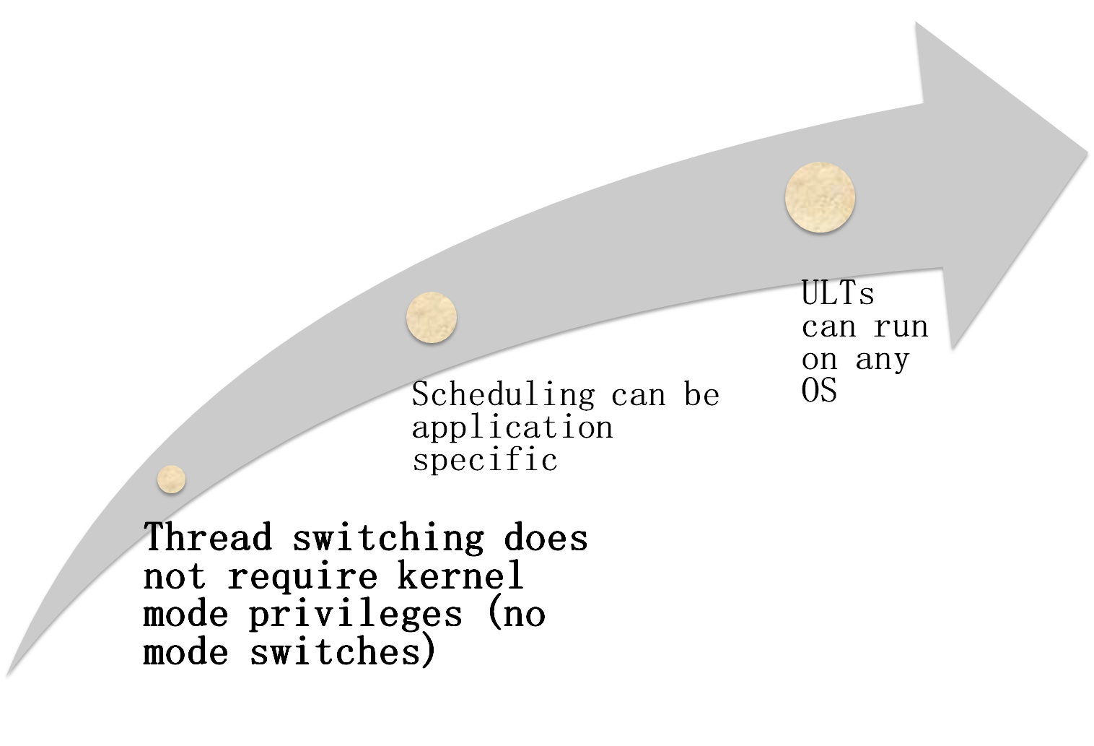
Notes:
There are a number of advantages to the use of ULTs instead of KLTs, including the following:
1. Thread switching does not require kernel mode privileges because all of the
thread management data structures are within the user address space of a single process. Therefore, the process does not switch to the kernel mode to do thread management. This saves the overhead of two mode switches (user to kernel; kernel back to user).
2. Scheduling can be application specific. One application may benefit most
from a simple round-robin scheduling algorithm, while another might benefit from a priority-based scheduling algorithm. The scheduling algorithm can be tailored to the application without disturbing the underlying OS scheduler.
3. ULTs can run on any OS. No changes are required to the underlying kernel
to support ULTs. The threads library is a set of application-level functions shared by all applications.

Slide 19
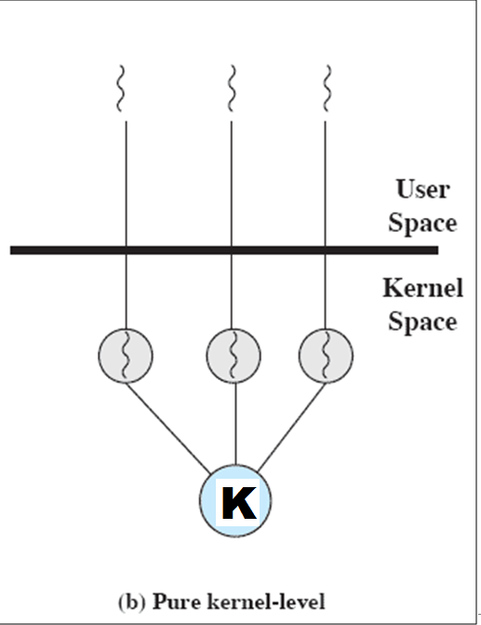
Kernel-Level Threads (KLTs)
  Thread management is done by the kernel (could call them KMT)
      no thread management is done by the application
    Windows is an example of this approach
Notes:
KERNEL-LEVEL THREADS
In a pure KLT facility, all of the work of thread management is done by the kernel. There is no thread management code in the application level, simply an application programming interface (API) to the kernel thread facility. Windows is an example of this approach. Figure 4.5b depicts the pure KLT approach. The kernel maintains context
information for the process as a whole and for individual threads within the process.

Slide 20
Advantages of KLTs
The kernel can simultaneously schedule multiple threads from the same process on multiple processors
If one thread in a process is blocked, the kernel can schedule another thread of the same process
Notes:
Scheduling by the kernel is done on a thread basis. This approach overcomes the two principal drawbacks of the ULT approach. First, the kernel can simultaneously schedule multiple threads from the same process on multiple processors. Second, if one thread in a process is blocked, the kernel can schedule another thread of the same process. Another advantage of the KLT approach is that kernel routines themselves can be multithreaded.

Slide 21
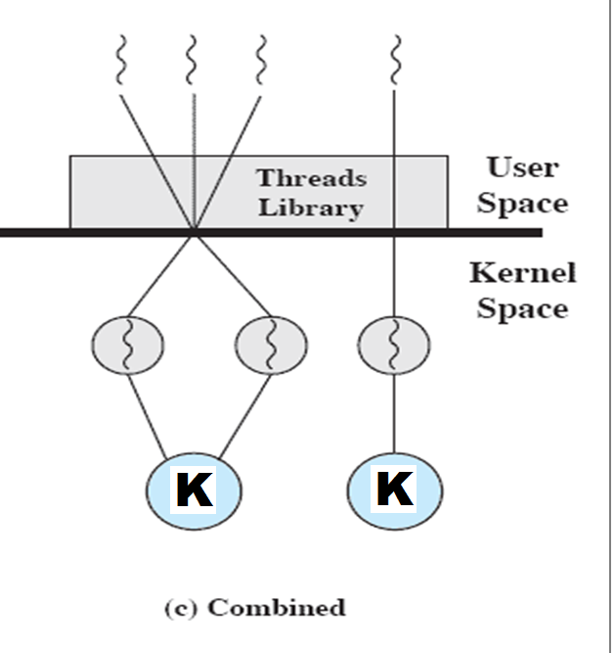
Combined Approaches
Thread creation is done in the user space
Bulk of scheduling and synchronization of threads is by the application
Solaris is an example
Notes:
COMBINED APPROACHES
Some operating systems provide a combined ULT/ KLT facility ( Figure 4.5c ). In a combined system, thread creation is done completely in user space, as is the bulk of the scheduling and synchronization of threads within an application. The multiple ULTs from a single application are mapped onto some (smaller or equal) number of KLTs. The programmer may
adjust the number of KLTs for a particular application and processor to achieve the best overall results. In a combined approach, multiple threads within the same application can run in parallel on multiple processors, and a blocking system call need not block the entire process. If properly designed, this approach should combine the advantages of the pure ULT and KLT approaches while minimizing the disadvantages. Solaris is a good example of an OS using this combined approach. The current Solaris version limits the ULT/KLT relationship to be one-to-one.

Slide 22

Questions…
1. Which one of the following is not shared by
threads?
A. program counter B. stack
C. both (a) and (b) D. none of the mentioned
Answer: Option C
2. A process can be:
A. single threaded B. multithreaded
C. both (a) and (b) D. none of the mentioned
Answer: Option C
3. If one thread opens a file with read privileges then:
A. other threads in the another process can also read from that file
B. other threads in the same process can also read from that file
C. any other thread can not read from that file
D. all of the mentioned
Answer: Option B

Slide 23
Questions…
4. The time required to create a new thread in an existing process is:
A. greater than the time required to create a new process
B. less than the time required to create a new process
C. equal to the time required to create a new process
D. none of the mentioned
Answer: Option B
5. When the event for which a thread is blocked occurs,
A. thread moves to the ready queue
B. thread remains blocked
C. thread completes
D. a new thread is provided
Answer: Option A
6. Termination of the process terminates:
A. first thread of the process
B. first two threads of the process
C. all threads within the process
D. no thread within the process
Answer: Option C

Slide 24
Questions…
7. The register context and stacks of a thread are deallocated when the thread:
A. terminated B. blocks
C. unblocks D. spawns
Answer: Option A
8. Thread synchronization is required because:
A. all threads of a process share the same address space
B. all threads of a process share the same global variables
C. all threads of a process can share the same files
D. all of the mentioned
Answer: Option D
9. A thread shares its resources (like data section, code section, open files, signals) with:
A. other process similar to the one that the thread belongs to
B. other threads that belong to similar processes
C. other threads that belong to the same process
D. All of these
Answer: Option C
10. A process having multiple threads of control implies :
A. it can do more than one task at a time
B. it can do only one task at a time, but much faster
C. it has to use only one thread per process
D. None of these
Answer: Option A

Slide 25
Assignments…
// C program to find maximum number of thread within a process
#include<stdio.h>
#include<pthread.h>
// This function demonstrates the work of thread which is of no use here, So left blank
void *thread ( void *vargp){}
int main()
{
int err = 0, count = 0;
pthread_t tid;
// on success, pthread_create returns 0 and on Error, it returns error number
// So, while loop is iterated until return value is 0
while (err == 0)
{ err = pthread_create (&tid, NULL, thread, NULL);
count++;
}
printf("Maximum number of thread within a Process is : %d\n", count);
return 0;
}

Slide 26
nilina@nilina-HP-Pro-3330-MT:~/Desktop/csen3113/thr$ gcc th1.c -o th1 -pthread
nilina@nilina-HP-Pro-3330-MT:~/Desktop/csen3113/thr$ ./th1
Maximum number of thread within a Process is : 32755

